Slide 1




Operating System principle
2019-2020-2

Slide 2

Part2 Process description and control
2.1 Precedence graph and Program execution
2.2 Process description
2.3 Process control
2.4 Process synchronization
2.5 Synchronization of classic processes
2.6 Process communication
2.7 basic concept of Threads
2.8 Implementation of threads

Slide 3
2.1 Precedence graph and Program execution
2.1.1 Precedence Graph
In order to better describe the sequence and concurrent execution of a program, we first introduce a precedence graph that describes the sequence of execution of a program.Precedence Graph refers to a Directed acyclic Graph, can be written as DAG (Directed Acyclic Graph), it is used to describe the process between execution order. Each node in the graph can be used to represent a process or procedures section, and a statement, to the edge between node represents Partial Order or Precedence Relation between two nodes.

Slide 4
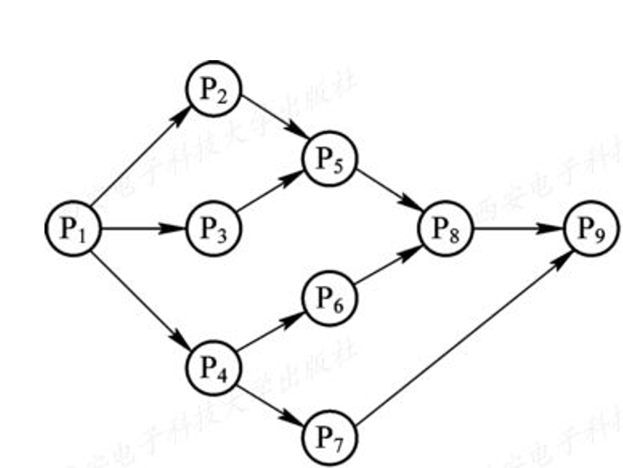
The precedence relation between processes (or programs) can be expressed as "→", if there is a precedence relation between processes P_{i} and P_{j}, it can be expressed as (P_{i}, P_{j})∈→, or as P_{i}→P_{j}, indicating that P_{i} must be completed before P_{j} starts execution. In this case, P_{i} is said to be the direct precursor of P_{j}, while P_{j} is said to be the direct successor of P_{i}. In the forward graph, the Node with no forward direction is called the Initial Node, and the Node with no successor is called the Final Node.

Slide 5
the precedence relationship is as follow:
P₁→P₂，P₁→P₃，P₁→P₄，P₂→P₅，P₃→P₅，P₄→P₆，P₄→P₇，P₅→P₈，P₆→P₈，P₇→P₉，P₈→P₉ or expressed as：
P ={(P₁, P₂), (P₁, P₃), (P₁, P₄), (P₂, P₅), (P₃, P₅), (P₄, P₆), (P₄, P₇), (P₅, P₈), (P₆, P₈), (P₇, P₉), (P₈, P₉)}

Slide 6

Note: Loops are not allowed in the precedence graph, otherwise impossible precedence relationships will be generated. S₂→S₃，S₃→S₂

Slide 7
Case1:
There are precedence relationships as follows:
P₁→P₃，P₁→P₄，P₁→P₅，P₂→P₃，P₂→P₄，P₂→P₅，P₃→P₆，P₄→P₈，P₅→P₇，P₆→P₈，P₇→P₈

Slide 8
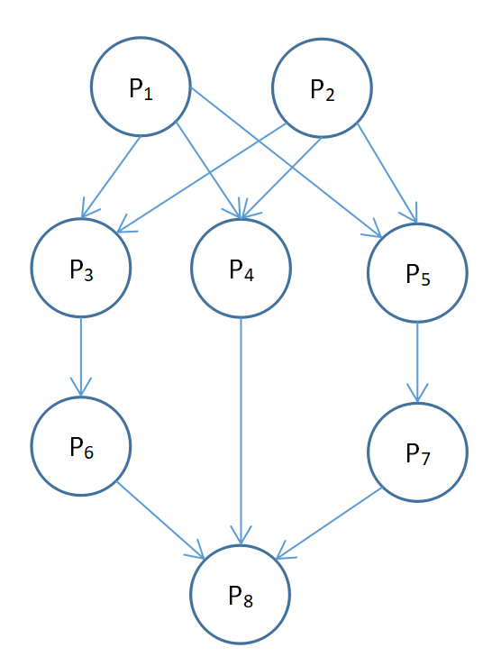

Slide 9
2.1.2 Sequential execution
1. Program execution in sequence
Typically, a program consists of several segments, each of which performs a specific function in a certain order of execution, with the latter segment running only after the current segment has finished.

Slide 10
main()
{ int a; int b; int c; scanf(“%d”,@a); scanf(“%b”,@b); c=a+b; printf(“%d\n”,c);
}
Such a precedence relationship exists between the three program segments mentioned above: I_{i}→C_{i}→P_{i}
I represents the input operation, C represents the calculation operation, and P represents the print operation, with arrows indicating the sequence of operations.

Slide 11
S₁: a :=x+y；
S₂: b :=a-5；
S₃: c :=b+1；
S₁→S₂→S₃
（a）Sequential execution about program
（b）Sequential execution about 3 statments
Figure 2-2 Precedence graph of Sequential execution

Slide 12
2. Characteristics of sequential execution of programs
It can be known from the above, in the sequence of execution of the program, with the following three characteristics: (1) Sequentiality: refers to the processor strictly in accordance with the order of execution of the program, that is, each operation must be completed before the beginning of the next operation; (2) Closure: refers to the program in a closed environment to run, that is, the program runs when the entire machine resources, the state of the resources (in addition to the initial state) only the program can change it, once the program began to execute, its execution results are not affected by external factors; (3)Reproducibility: refers to as long as the environment when the program is executed and the initial conditions are the same, when the program is repeatedly executed, whether it is from beginning to end without stopping, or "stop-and-go" execution, can get the same results. This feature of sequential execution of the program brings great convenience for programmers to detect and correct errors in the program.

Slide 13
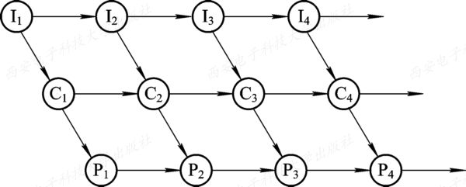
2.1.3 Concurrent execution
1. Concurrent execution of program
Figure 2-3 precedence graph of concurrent execution of program

Slide 14
As can be seen from figure 2-3, there is a precedence relationship I_{i}→C_{i}, I_{i}→I_{i+1}, C_{i}→P_{i}, C_{i}→C_{i+1}, P_{i}→P_{i+1}, while I_{i+1} overlapped with C_{i} and P_{i-1}. In other words, there is no precedence relationship between P_{i-1} and C_{i} and I_{i+1}, and it can be executed concurrently.
For program segments with the following four statements: S₁: a :=x+2
S₂: b :=y+4
S₃: c :=a+b
S₄: d :=c+b
Please to draw the precedence graph？

Slide 15
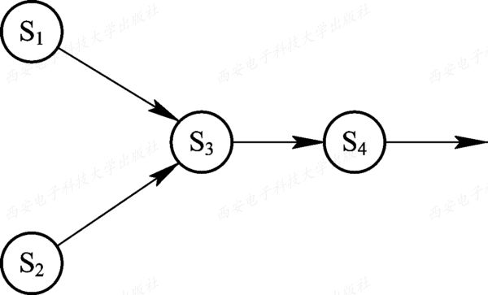
Figure 2-4 Precedence graph about 4 statement

Slide 16
2. Characteristics of concurrent execution of programs
After introducing the function of program between concurrent execution, while increase the throughput of the system and resource utilization, but because they share system resources, and cooperate with each other to accomplish the same task, which lead to form the mutual restriction relation in the concurrent execution of the programs. It will bring new features to program concurrently.
(1) Discontinuity
Mutual restriction will lead to concurrent execution of the program has the discontinuous law about "execution - pause - execution".

Slide 17
(2) Loss of closure
When there are multi-programs of concurrent execution in the system, these programs share various resources in the system, these programs will change the state of these resources, When one of them is running, its environment is bound to be affected by other programs.

Slide 18
(3) non-reproducibility
When a program is executed concurrently, it also loses its reproducibility due to its loss of closure.
Program A Program B
A₁: N=N+1 B₁: print(N)
B₂: N=0;

Slide 19
1. A₁ 1-- B₁ 1--B₂ 0
2. B₁ 0--B₂ 0--A₁ 1
3. B₁ 0-- A₁ 1--B₂ 0 if initial value N = 0.

Slide 20
2.2 Process Description
2.2.1 Process definition and characteristics
1. Process definition
In the multi-program environment, the execution of programs is concurrent, at this time, they will lose their closure, and have the characteristics of intermittent, and the results of their operation cannot be reproducible. Thus, it is decided that the normal program cannot participate in concurrent execution, otherwise, the program will run meaningless. In order to enable programs to execute concurrently, and to describe and control programs that execute concurrently, the concept of "process" was introduced.

Slide 21
In order for each program (including data) participating in concurrent execution to run independently, a specialized data structure, called a Process Control Block (PCB), must be configured in the operating system. The system uses PCB to describe the basic situation and activities of the process, and then controls and manages the process. In this way, the process entity (also known as the process image) is composed of the program segment, the associated data segment, and the PCB. In general, we refer to the process entity simply as a process. For example, the so-called creation process is essentially a PCB in the process entity; The termianted process, in essence, is the PCB of the cancellation process.

Slide 22
A process is defined as :(1) a process is an execution of a program. (2) a process is an activity that occurs when a program and its data are executed sequentially on the processor. (3) a process is a process in which a program with independent functions runs on a data set, and it is an independent unit of the system for resource allocation and scheduling.

Slide 23
2. Process characteristics
Process and program are two distinct concepts. In addition to the PCB structure that process does not have, process also has the following characteristics:
(1) dynamic
The essence of a process is the execution process of a process entity. Therefore, dynamics is the most basic feature of a process.
(2) concurrency
Concurrency is when multiple process entities are stored in memory and can be run simultaneously for a period of time.

Slide 24
(3) independence
Independence means that the process entity is a basic unit that can run independently, obtain resources independently and accept scheduling independently.
(4) asynchronism
Asynchrony is when processes run asynchronously, moving forward at separate, unpredictable speeds.

Slide 25
2.2.2 The basic state and transitions of a process
1. Three basic states of a process
Since multiple processes share system resources during concurrent execution, they exhibit intermittent running patterns during operation, so a process may have a variety of states during its life cycle. In general, each process should be in at least one of three basic states :
(1) Ready state.
(2) Running state.
(3) Block state.

Slide 26
2. Three basic state transitions
Processes often undergo state transitions while running. For example, a process in the ready state can execute after the scheduler assigns a processor to it, and accordingly, its state changes from the ready state to the running state; An running process (the current process) changes from running to ready if the processor is deprived of execution because the time slice allocated to it has run out. If an event occurs that impedes the execution of the current process (for example, when a process accesses a critical resource that is being accessed by another process) and makes it impossible to continue, the process state changes from running to block. Figure 2-5 shows the three basic states of the process and the transition relationships between the states.

Slide 27
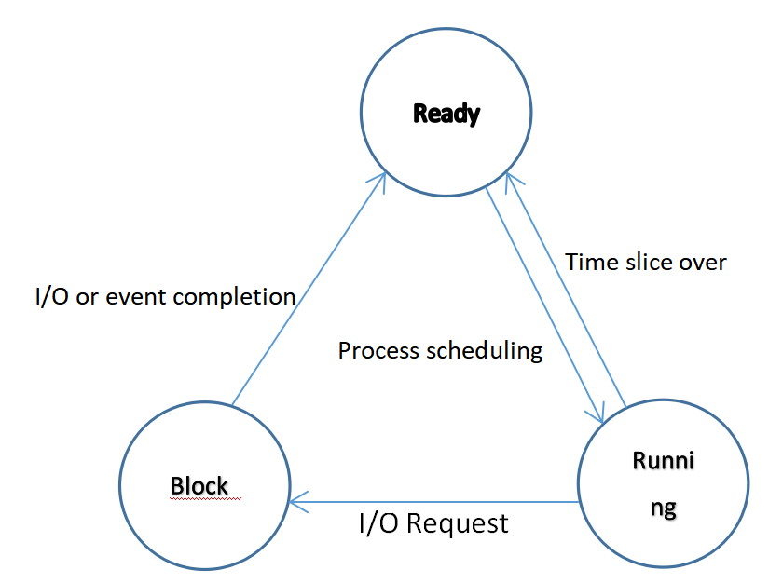
Figure 2-5 Three basic states of a process and their transitions

Slide 28
3. Create(New) state and terminated state
1) Create(New) state
As mentioned earlier, processes are generated by creation. Creating a process is a very complex process, and it usually takes several steps to complete: for example, the process first applies for a blank PCB, and fills the PCB with information for controlling and managing the process; The process is then allocated the resources necessary to run the process; Finally, put the process into the ready state and insert it into the ready queue. However, if the resources required by the process cannot be satisfied, such as the system does not have enough memory so that the process cannot be loaded, then the creation work is not completed, the process can not be scheduled to run, so the state of the process at this time is called the create state.

Slide 29
2) Terminated state
Process termination also goes through two steps: first, wait for the operating system to clean up, and finally clear its PCB, and return the PCB space to the system. When a process reaches its natural end point, or has an insurmountable error, or is terminated by the operating system, or by another process that has termination rights, it enters a termination state. A process that enters a dead state cannot execute again, but still keeps a record in the operating system that holds the status code and some timing statistics for other processes to collect. Once the other process has finished extracting its information, the operating system will delete the process, zero its PCB, and return the blank PCB to the system. Figure 2-6 shows a diagram of the five states and transitions of the process after the created and terminated states are added.

Slide 30
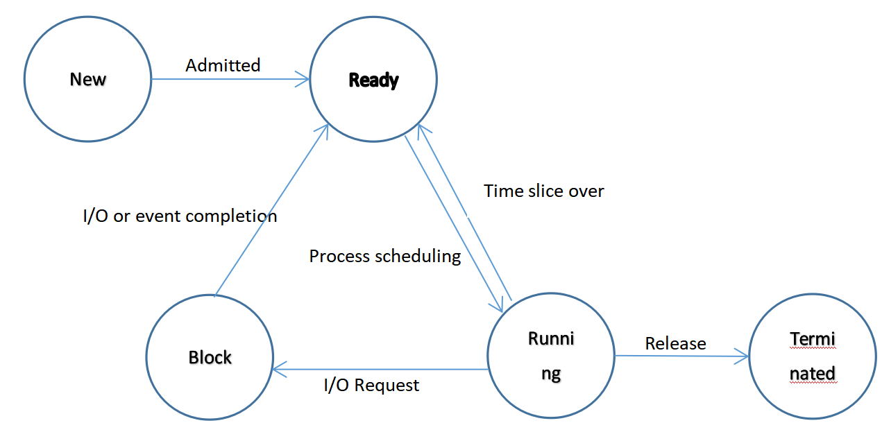
Figure 2-6 Five basic state and transition of process

Slide 31
2.2.4 Data structure in process management
1. The data structure used to manage control in an operating system
In a computer system, a data structure is set for each resource and each process to represent its entity, which is called a resource information table or process information table, which contains information such as the identity, description, state of the resource or process, and a batch of Pointers. Through these Pointers, the information table of the same resource or process, or the resource information table occupied by the same process, can be classified and linked into different queues to facilitate the search of the operating system.

Slide 32
As shown in figure 2-9, these data structures managed by OS are generally divided into the following four categories: memory table, device table, file table, and process table for process management, which is often referred to as process control block(PCB).

Slide 33
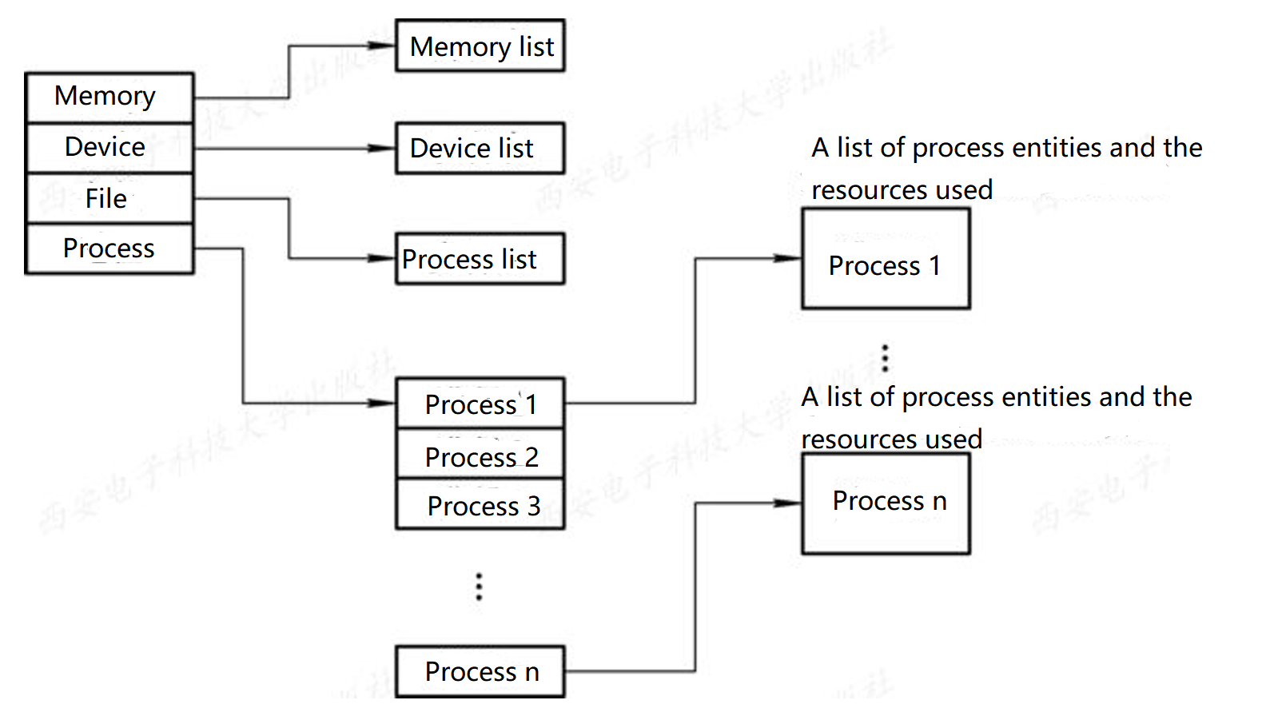
Figure 2-9 The general structure of the operating system control table

Slide 34
2. Process control block PCB function
(1) as a mark of independent operation of basic units.
(2) intermittent operation can be realized.
(3) provide the information needed for process management.
(4) provide the information needed for process scheduling.
(5) realize synchronization and communication with other processes.

Slide 35
3. Information in the process control block
In the process control block, it mainly includes the following four aspects of information.
1)Process identifier
Process identifier is used to uniquely identify a process. A process typically has two types of identifiers :
(1) external identifiers.
(2) internal identifier.

Slide 36
2) processor state
Processor state information, also known as the processor's context, is primarily composed of the contents of the processor's various registers.

Slide 37
3) Process scheduling information
When OS is scheduling, it is necessary to know the state of the process and information about the process scheduling, including:
①Process state, which indicates the current state of the process, is used as the basis for process scheduling and swapping;
② Process priority, which is an integer used to describe the priority level of a process using the processor;
③Other information required for process scheduling, which is related to the process scheduling algorithm adopted, such as the sum of time the process has waited for the CPU, the sum of time the process has executed, etc.
④ Event, refers to the process from the running state to the block state waiting for the event, that is, the reason for the blocking.

Slide 38
4) Process control information
Refers to the necessary information for process control, it includes:
(1) the address of the program and data, the process in the entity of the program and data memory or external storage (first) address, in order to rescheduled to the process execution, can find its program and data from the PCB;
(2) process synchronization and communication mechanism, which is necessary to achieve process synchronization and process communication mechanism, such as message queue pointer, semaphore, they may be all or part of the PCB;
(3) resource list, which lists all the resources (except CPU) that the process needs during the run, and a list of resources that have been allocated to the process;
(4)The link pointer, which gives the first address of the PCB of the next process in the queue where the process (PCB) is located.

Slide 39
4. How process control blocks are organized
There are usually dozens, hundreds, or even thousands of PCBs in a system. In order to manage them effectively, they should be organized in an appropriate way. There are three commonly used ways of organization.
(1) Linear mode: all PCBs in the system are organized in a linear table, and the first address of the table is stored in a dedicated area of memory. This approach is simple and inexpensive to implement, but requires the entire table to be scanned every time a lookup occurs, so it is suitable for systems with a small number of processes. Figure 2-10 shows the PCB organization of the linear table.

Slide 40
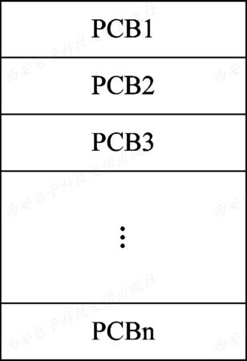
图2-10 PCB linear Schematic diagram

Slide 41
(2) Link mode: that is, PCB with the same state process is linked into a queue through the link word in the PCB. In this way, you can form ready queues, several block queues, blank queues, and so on. For ready queues, PCB's are often arranged from high to low in order of priority of the process, with the high-priority process PCB's being placed at the front of the queue. Similarly, PCB's of blocked processes can be arranged into multiple blocking queues, such as queues waiting for the completion of I/O operations and queues waiting for memory allocation, depending on the blocking reasons. Figure 2-11 shows an organization of linked queues.

Slide 42
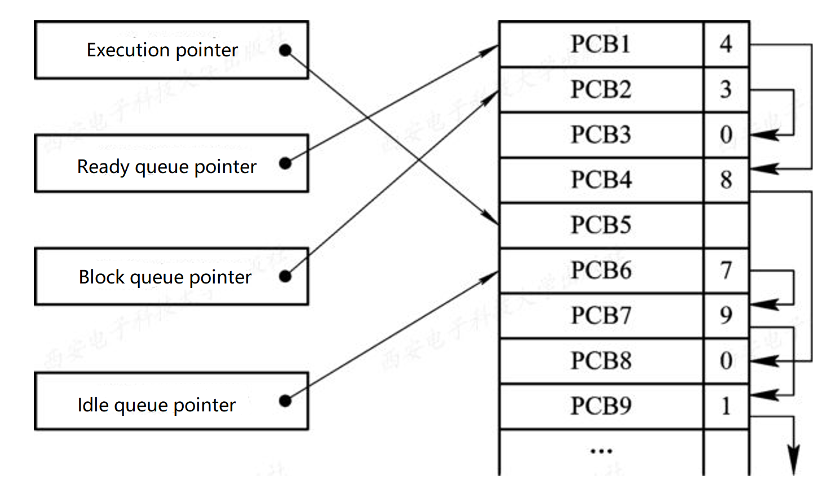
Figure 2-11 Schematic diagram of PCB link queue

Slide 43
(3) Index mode, that is, the system according to the state of all the process, the establishment of several index tables, such as the ready index table, the blocking index table, and the first address of each index table in memory recorded in some special unit of memory. In the table entry of each index table, the address of a PCB with the corresponding state in the PCB table is recorded. Figure 2-12 shows the PCB organization of the indexing approach.

Slide 44
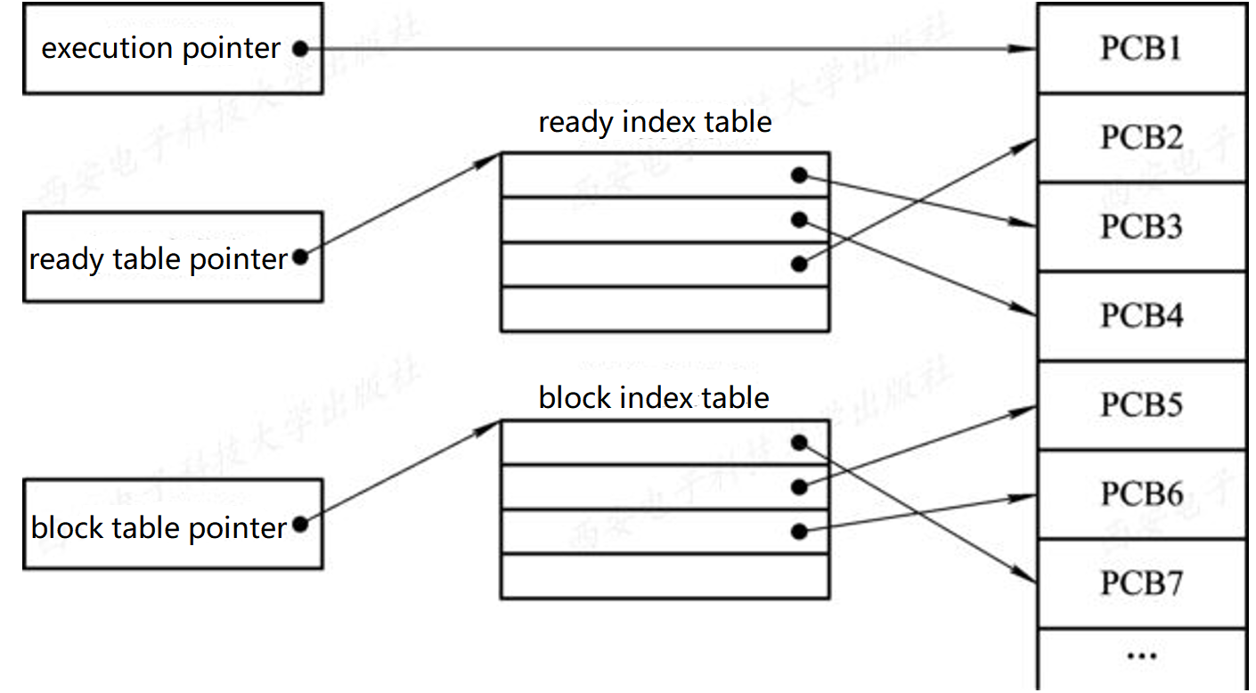
Figure 2-12 Organize PCB by index

Slide 45
2.3 Process control
Process control is the most basic function in process management, which mainly includes the functions of creating a new process, terminating the completed process, placing the process which cannot continue running due to the abnormal situation in the blocking state, and taking charge of the state transition during the process running. For example, when an executing process is temporarily unable to continue execution because it is waiting for an event, it will be put into a blocking state, and the process will be put into a ready state after the expected event occurs. Process control is generally implemented by primitives in the OS kernel.

Slide 46
2.3.1 Process creation
1. Process hierarchy
In OS, one process is allowed to create another process, usually by calling the process that created the process is the parent process; and the process that was created is the child process. A child process can go on to create more grandchildren, thus forming a hierarchy of processes.

Slide 47
2. Process Graph
The Process Graph is introduced to visualize the family relationship of a Process. A process diagram is a directed tree that describes the relationships between processes, as shown in figure 2-13.

Slide 48
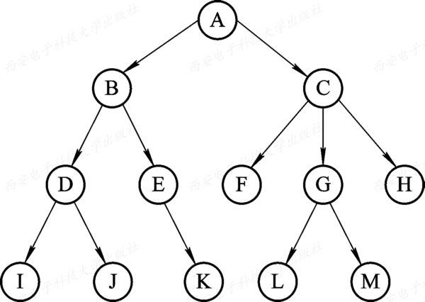
Figure2-13 Process tree

Slide 49
3. The event that causes the process to be created.
To allow programs to run concurrently, create separate processes for them. There are four types of typical events that cause one process to create another:
(1) user login.
(2) job scheduling.
(3) provide services.
(4) apply request.

Slide 50
4. Creation of Process
Whenever a request to create a new process occurs in the system, the OS invokes the process creation primitive( Create ) to create a new process:
(1) apply for a blank PCB, obtain a unique digital identifier for the new process, and obtain a blank PCB from the PCB collection.
(2) allocate resources for the new process to run, including various physical and logical resources such as memory, files, I/O devices, and CPU time.
(3) initialize the process control block (PCB).
(4) if the process ready queue can accept the new process, the new process is inserted into the ready queue.

Slide 51
2.3.3 Termination of Process
1. The event that cause termination of Process
(1) normal end
(2) Exception end
(3) external intervention

